Slide 1
Presentation on Credit EDA Case Study
Presented by :
Priya
DS50 BATCH

Slide 2
What is Credit Exploratory Data Analysis?
Credit risk analysis is the real time business scenario which is run by the company to analysis that to whom they should provide loans based on their profile, that weather they are capable of repaying of their loans and thus, it help company from avoiding any kind of financial loss.

Slide 3
Steps performed to analysis the given Data:
Missing Values
Handling Outliers
Correlation Between multiple variable
Data Visualisation
Establishing cause and effect

Slide 4
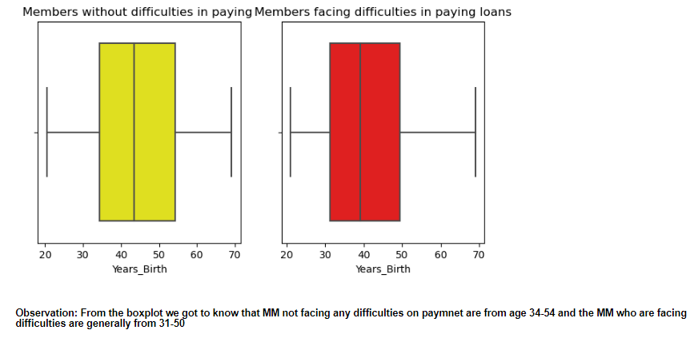
Univariate Analysis on continuous Data Age group
Here we fetched that mostly 34-54 age people are not facing much difficulties and young people seems to be a defaulters

Slide 5
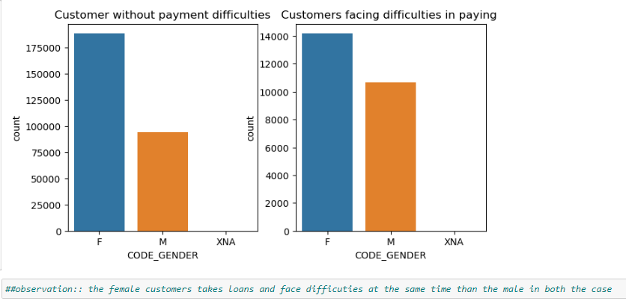
Male, Female Analysis:
As per analysis the Female are the one who takes more loan ,also face difficulties while repaying them in both the case, females are more evolved

Slide 6
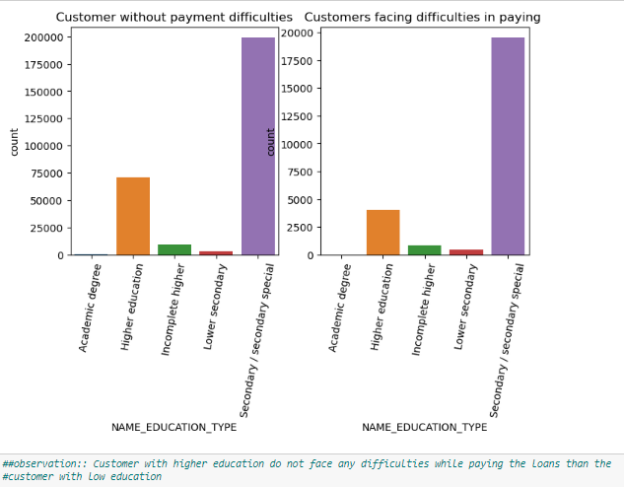
Analysis on NAME_EDUCATION_TYPE
Here as checked, customer with higher education do not face much difficulties in repaying loans, on the other hand the secondary special class face much issue while repayment

Slide 7
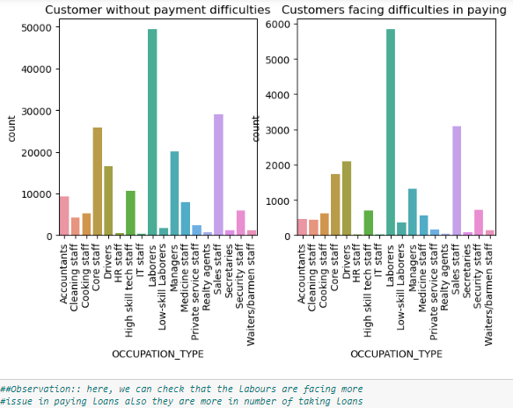
Analysis on Occupation Type
As per observation: Labors are the one who faces more issue while paying loans also they take loans

Slide 8
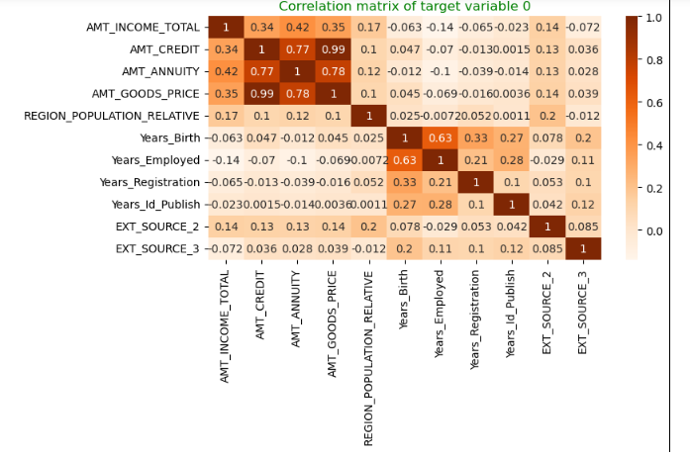
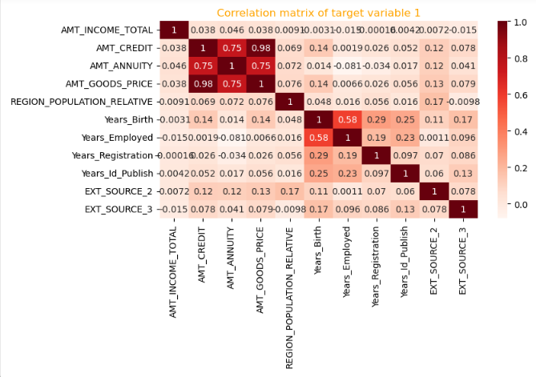
Correlation of Continuous Variable of defaulter data frame & non defaulters df
If we check the observation : both the heat map are highly correlated to each other, the ,Good price, Amt_Annuty and amount credit are highly correlated to each other

Slide 9
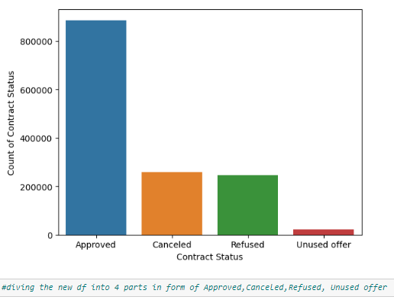
Count of Contract Status:

Slide 10
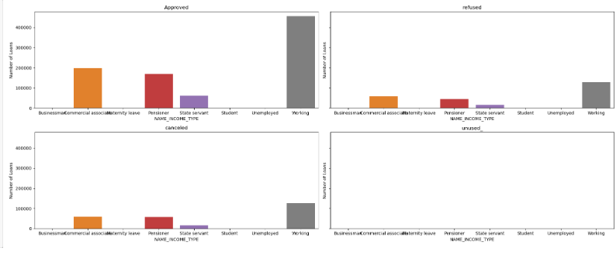
Analysis on NAME_INCOME_TYPE
working people take more loans than other and approved and commercial people also take more loans

Slide 11
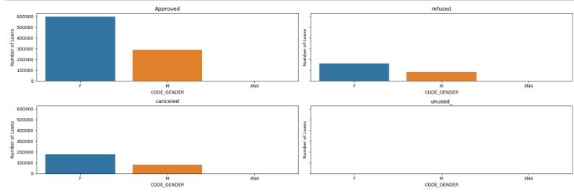
Male, Female Loan Approval
Female being more approved and in comparative to Male

Slide 12
Recommended Group where loan can be credited
Customer who are working as state servant
Old people of income group
Client with High Income category
Female Candidate
Clients who’s previous loan was approved

Slide 13
Defaulter Group
Male Clients
Previously refused loans status group
Lower secondary educated clients are more in number to be defaulted

